Slide 1
Variations of Temperatures
[In engine cooling systems]

Slide 2
Introduction:
About 35% of total chemical energy that enters the engine in fuel is converted to useful crankshaft work.
About 30% of fuel energy is carried away from the engine in the exhaust flow in the form of enthalpy and chemical energy.
This leaves about one third of the total energy that must be dissipated to the surrounding by some mode of heat transfer.
This is achieved by cooling systems; either air-cooling or water cooling.

Slide 3
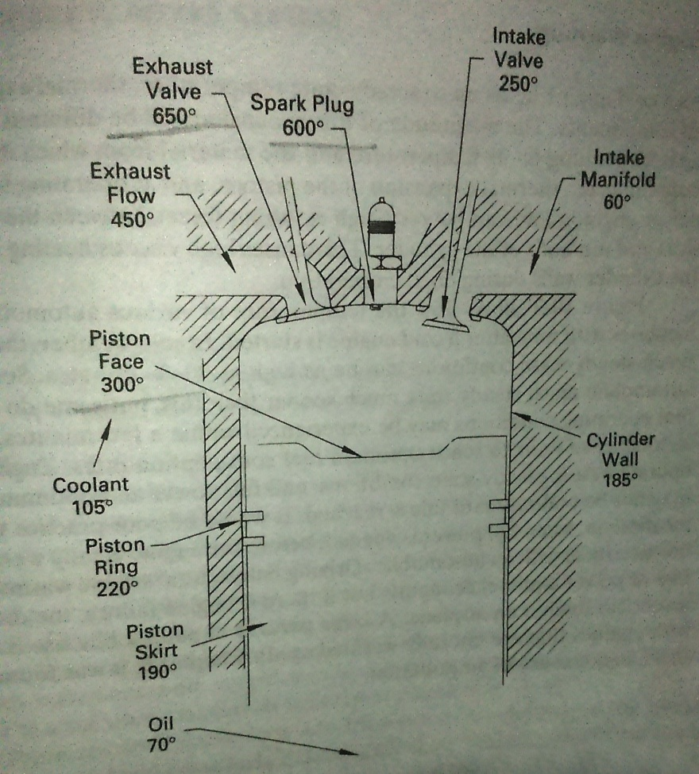
Temperature values at steady state conditions:
Hottest spots:
Around spark plug
Exhaust valve and port
Face of the piston
Also, they are difficult places to cool.

Slide 4
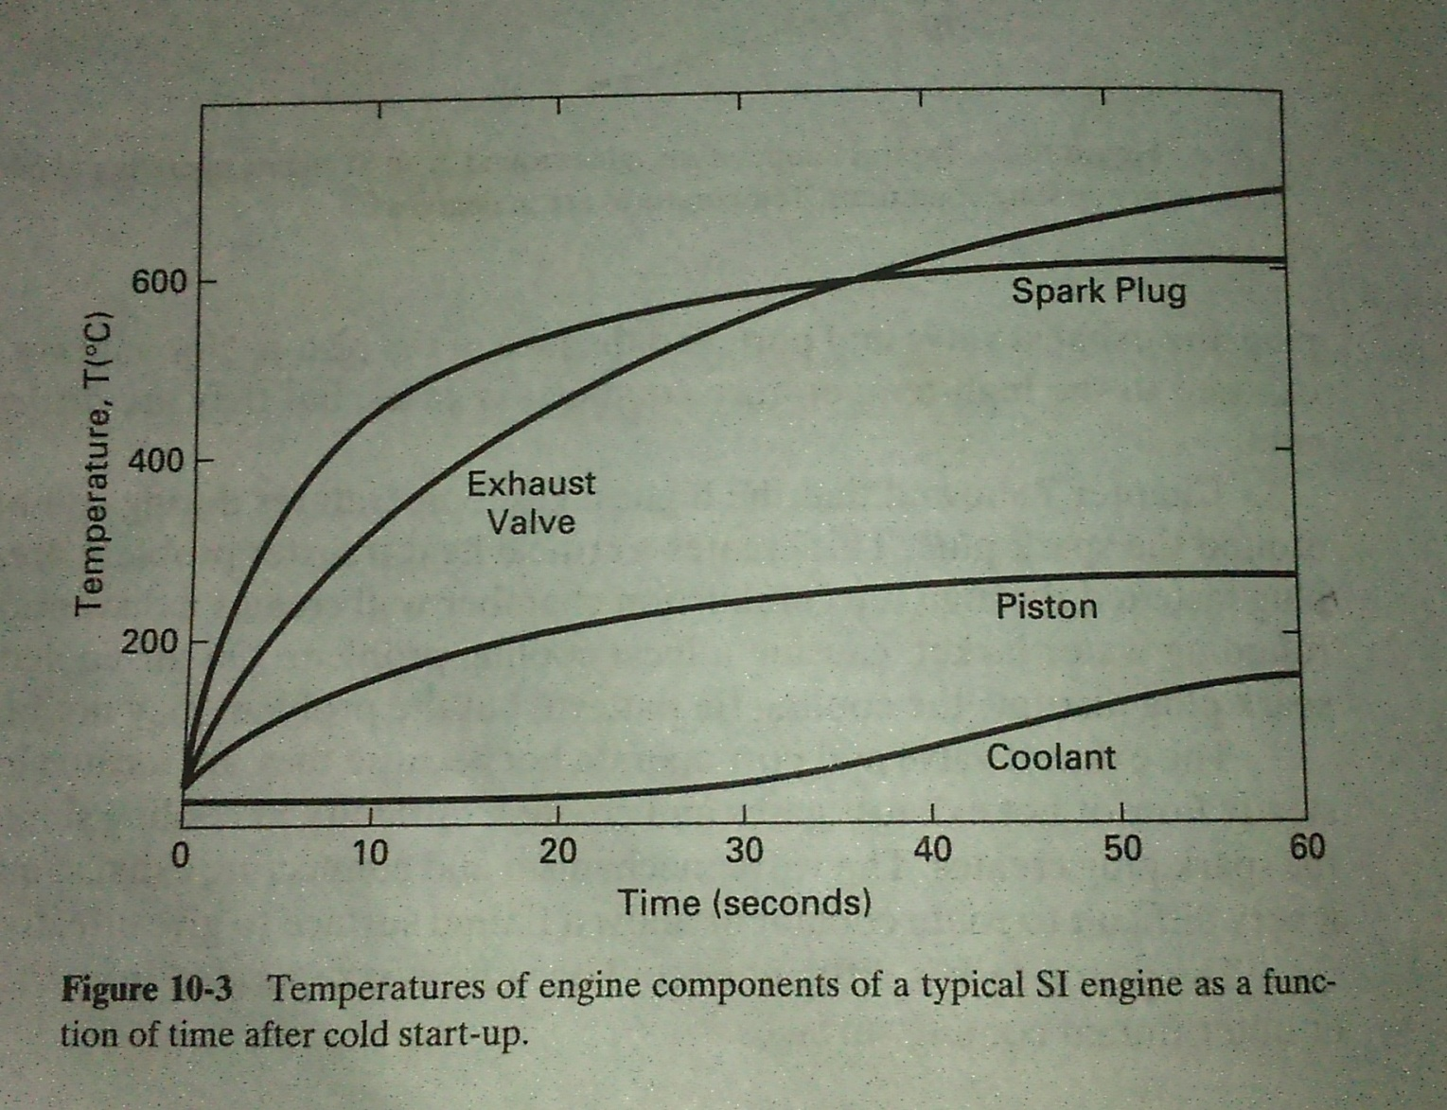
Variation of temperatures in engine cooling systems:

Slide 5
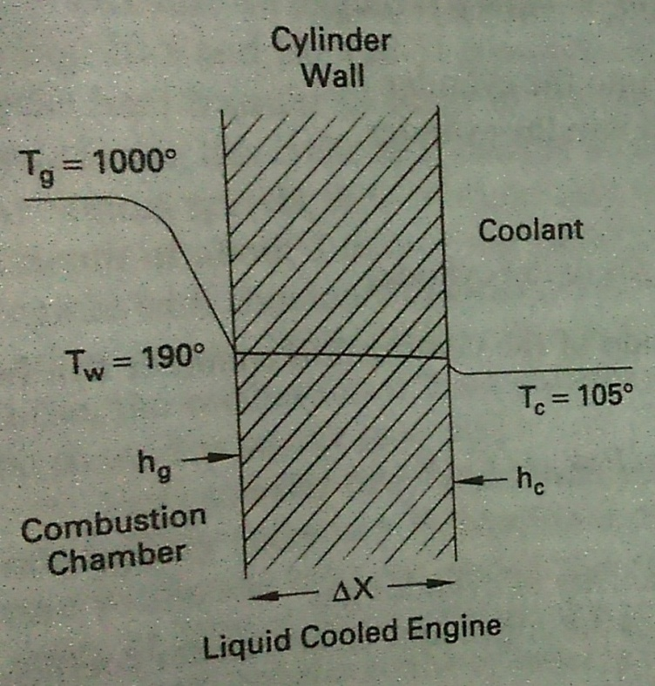
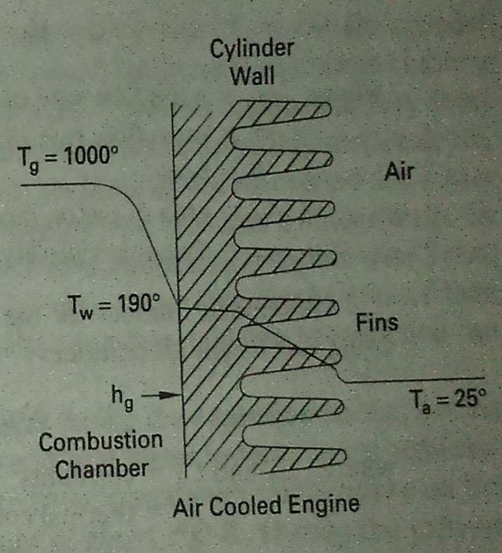
Associated formula and notations:
Then, co-relation between temperatures and heat transfer rates is given by:
q = Q/A = (Tg-Tc)/[(1/hg)+(dx/k)+(1/hc)]

Slide 6
Thank You!

